Slide 1
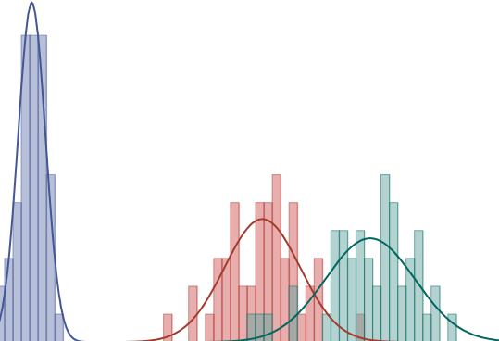
simulation

Slide 2
Objectives
Motivation for Simulation
Simulation Modeling
Components & Steps
Using Built-in Excel tools (if time allows)
Using @Risk
Interpreting results and confidence intervals

Slide 3
Introduction to simulation
Goal: make decisions in the presence of uncertain events (e.g. changes in demand or price)
Take advantage of distribution of uncertain events, and correspondingly, distribution of outcome
Use simulation to consider multiple scenarios and assess the risk associated with a decision
Make decision based on expected outcome and risk

Slide 4
Simulation & Decisions
Suppose that the quality of a decision is evaluated based on profits
In production planning, profits depend on the quantity produced (decision) as well as on the demand (uncertain)
Hence, profits (Y) are now a random variable dependent on the uncertain events as well as on our decision
We can capture the relationship between demand (inputs), decisions and profits in a model
And simulation can provide a forecast of the possible profits in a probabilistic way

Slide 5
Random Variables
A random variable is any quantity which cannot be predicted or set with certainty
Many “inputs” in a model are actually random variables:
the future cost of raw materials
future interest rates
future number of employees in a firm
expected product demand
Decisions made on the basis of uncertain information often involve risk (for example: potential for loss)

Slide 6
Components
Model:
Abstraction of the business problem that captures the interaction of the different forces in the decision problem
Uncertain inputs:
Quantities or conditions that cannot be predicted with certainty (random variables in the model.)
Decisions:
Quantities or conditions that are under the control of the decision maker, e.g. ads selection, product price, portfolio selection, research and development budget, etc.
Outputs:
Measure of decision performance –aligns with company goals, e.g. profit, sales quantity, return on investment, market share

Slide 7
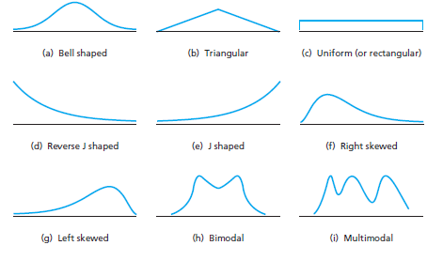

Simulation Modeling
Decisions:
Production Plan
Order Quantity
Investment Portfolio
Uncertain inputs:
Demand
Cost of raw materials
Rate of return
Model
Outputs:
Total Profit
Total Return
Total Revenue
How does the variability in the inputs manifest in the distribution of the outputs?

Slide 8
Different Approaches to Risk Analysis
Best case: plug in the most optimistic values for each of the uncertain cells
Worst case: plug in the most pessimistic values for each of the uncertain cells
Robust optimization: a view that worst-case analysis is the only “correct” course of action
But what is the distribution of possible outcomes between the best and worst cases?

Slide 9
Performance Measure Distributions
worst case
best case
worst case
best case
worst case
best case
worst case
best case

Slide 10
Simulation
Values for uncertain inputs are selected in a manner that represents the probability distribution that the uncertain inputs take
The computer generates hundreds (thousands, millions) of scenarios
We can analyze the results of these scenarios to make decisions using solid empirical evidence

Slide 11
Simulation: 4 step process
1) Identify the uncertain inputs in the model.
2) Understand how they vary (what distribution + parameters they follow) and build a model that explains consequences of decision if input were fixed.
3) Replicate the model n times:
Use different input values, generated from the distribution that the inputs come from
Record the value of the performance measure.
4) Analyze the sample values collected on the performance measure.

Slide 12
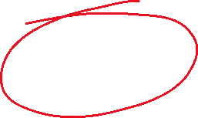
Simulation Modeling
Decisions:
Production Plan
Order Quantity
Investment Portfolio
Uncertain inputs:
Demand
Cost of raw materials
Rate of return
Model
Outputs:
Total Profit
Total Return
Total Revenue
How does the variability in the inputs manifest in the distribution of the outputs?

Slide 13
Example: Milk order
A store manager needs to place its weekly order for dairy products, among them crates of one-gallon whole milk. A crate contains 4 gallons. A gallon of milk sells for $3.60 and cost $2.90. Any unsold milk can be sent back for $0.50 at the end of the week.
She knows from past experience that weekly demand is approximately Normal with mean 600 gallons and standard deviation 80.
How many crates should she order for the upcoming week?

Slide 14
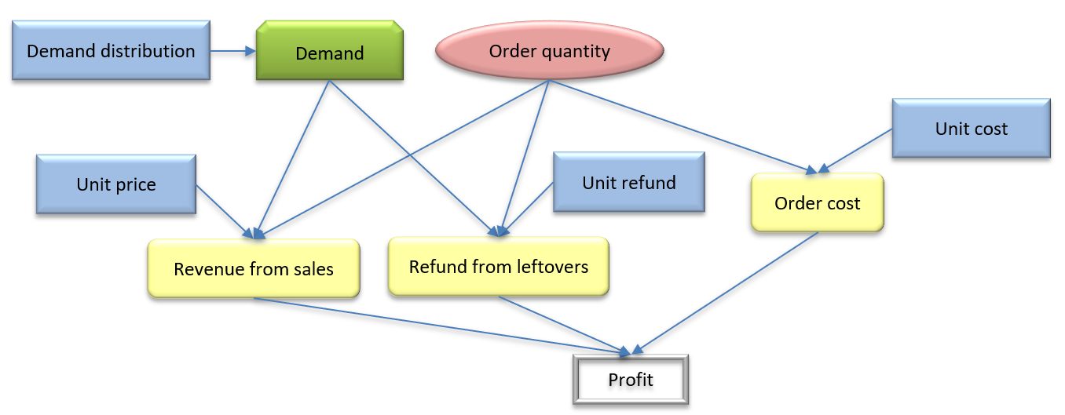
Example: Milk order – big picture

Slide 15
Milk order: model

Slide 16
Using built-in Excel tools
Functions:
RAND(): generates a random numbers between 0 and 1.
Inverse probability functions: NORM.INV(), BETA.INV(), BINOM.INV(), F.INV(): compute a value from a given distribution
Example:
NORM.INV(0.3, 0, 1): computes the value that follows a normal distribution with mean of 0 and standard deviation of 1, and has a probability of 0.3
NORM.INV(RAND(), 0, 1): generate a random variable that follows a normal distribution with mean of 0 and standard deviation of 1

Slide 17
Using built-in Excel tools
Summary table:
AVERAGE(): expected values
STDEV.S(): standard deviation of a sample
COUNTIF(): count the values that meet a condition

Slide 18
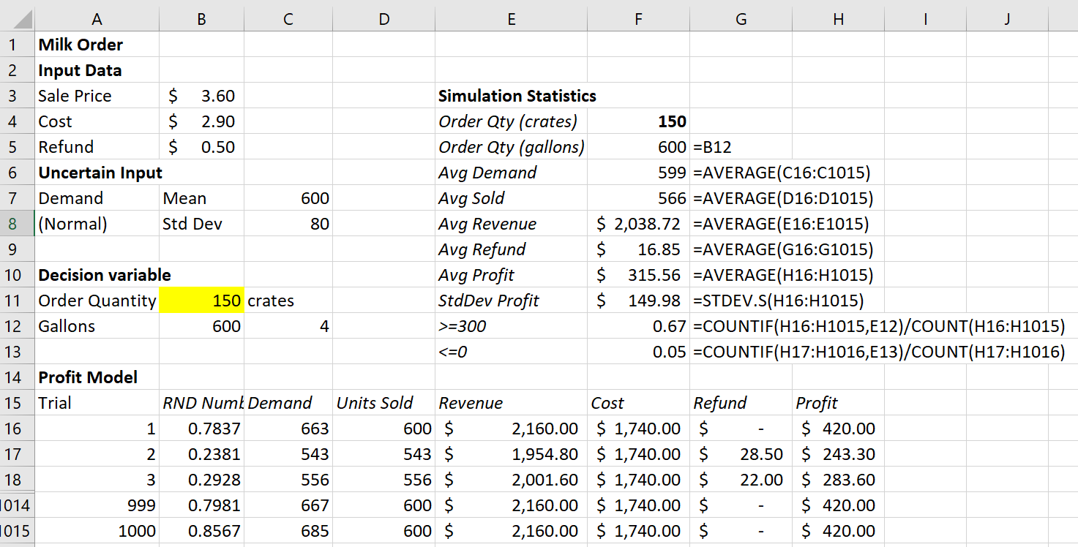
Milk order: simulation
(Milk Order_excel simulation.xlsx)

Slide 19
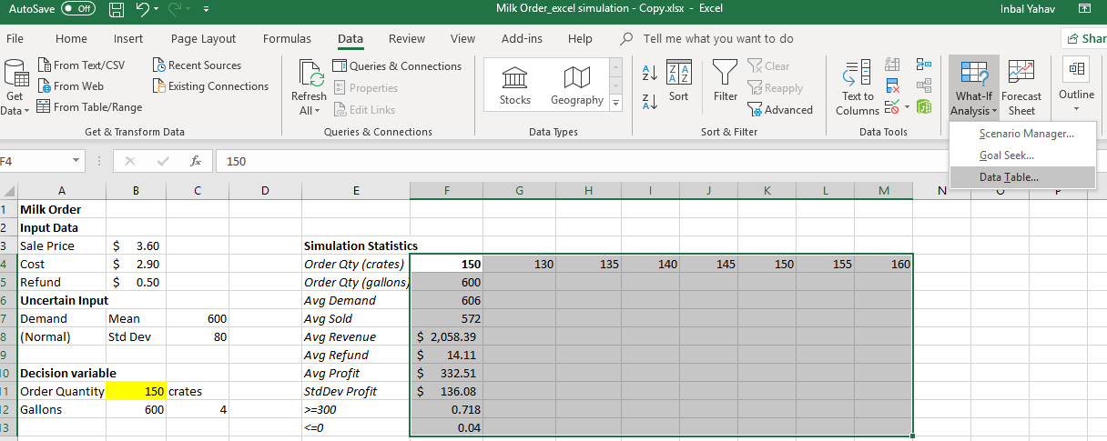
How many crates?
Use data tables to investigate alternative order quantities
(Milk Order_excel alternatives.xlsx)

Slide 20
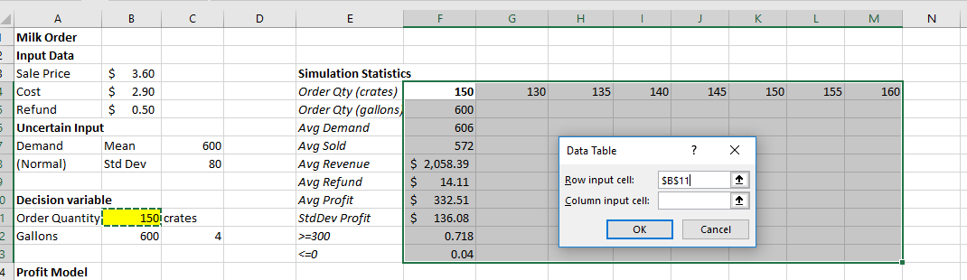
How many crates?
Use data tables to investigate alternative order quantities
(Milk Order_excel alternatives.xlsx)

Slide 21
How many crates?
Use data tables to investigate alternative order quantities
(Milk Order_excel alternatives.xlsx)

Slide 22
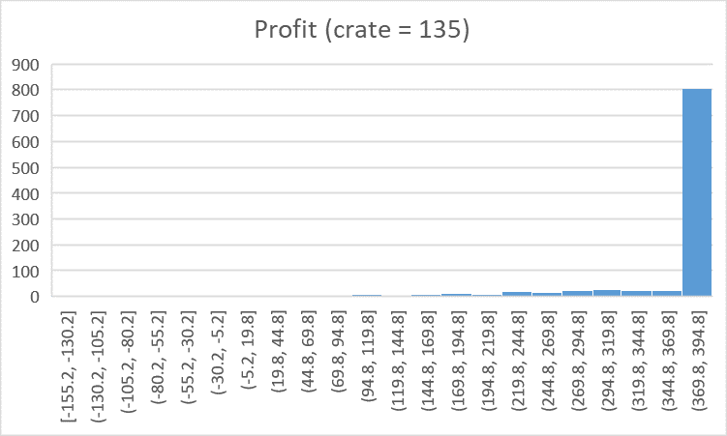
Profit (at 135 crates)

Slide 23
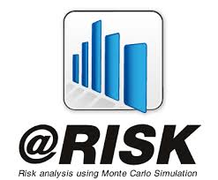
Simulation with

Slide 24
What is @RISK?
@RISK is a powerful spreadsheet add-in that simplifies spreadsheet simulation.
It provides:
functions for generating random numbers
commands for running simulations
graphical & statistical summaries of simulation data
How do you start @RISK?
If you have installed the Palisade Decision Tools Suite, you should be able to open it from the start menu.

Slide 25

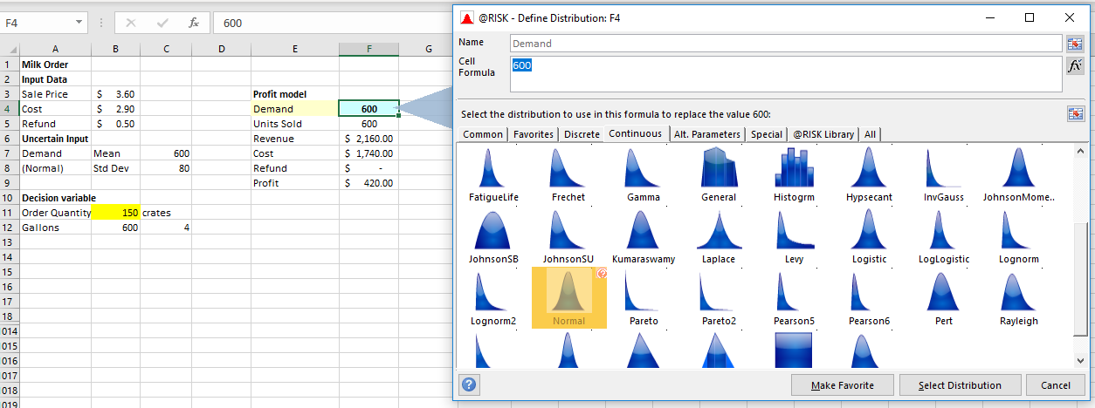
@RISK Simulation Model: define Inputs
Uncertain Inputs: Go to the @RISK Ribbon. Click on Define Distribution, and select the appropriate distribution. This allows you to tell Excel what distribution the random number in that cell follows. Note that you can also directly enter the @RISK function name, by clicking on Insert function.

Slide 26
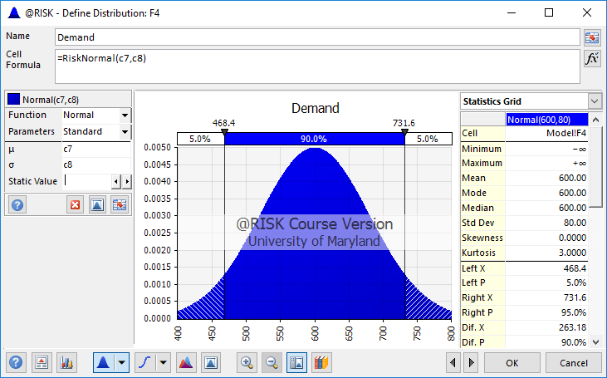
Define input parameters

Slide 27
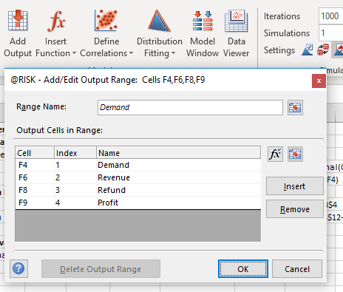
@RISK Simulation Model: define Outputs
Tracking Output Cells: Go to the cell you want to track in the output and click on “Add Output”. This tells Excel that you are interested in tracking the random variable in this Output Cell in your simulation. Notice @RISK has put in a function + RISKOutput() to the cell you are tracking.

Slide 28
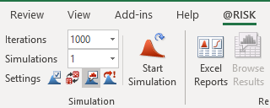
@RISK: Running a Simulation
To run a simulation model in @RISK first type in the number of iterations (say 1000) under the @RISK Ribbon. Click on Start Simulation to start the simulation run.

Slide 29
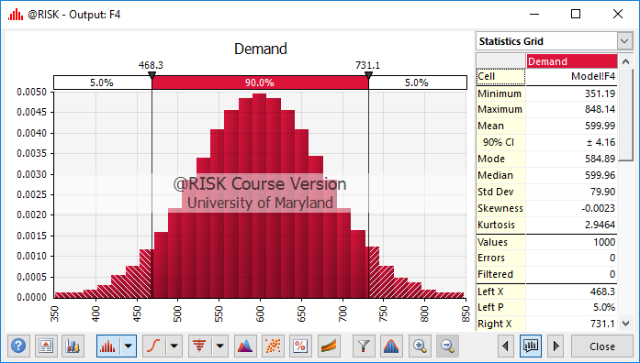
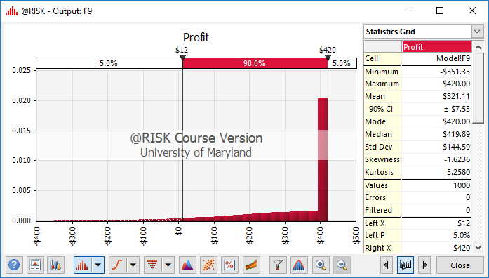
@RISK: Running a Simulation
At the end of the simulation you can view the output by going to the output cell of interest and double clicking on it. (If it does not show, go to the cell of interest and click on Browse Results).
Results of the simulation are displayed visually as a probability density function. You can also change the view to a cumulative distribution function.
Charts can be cut and pasted into a regular word or excel document (use copy to clipboard option).

Slide 30
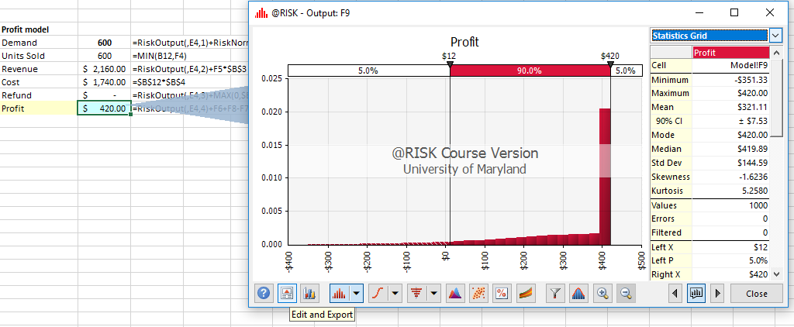

@RISK: Running a Simulation
Clicking on Edit and Export (3rd button from left), on the chart, and selecting “Quick Report” provides a statistical summary of the simulation output.
Detailed report:

Slide 31
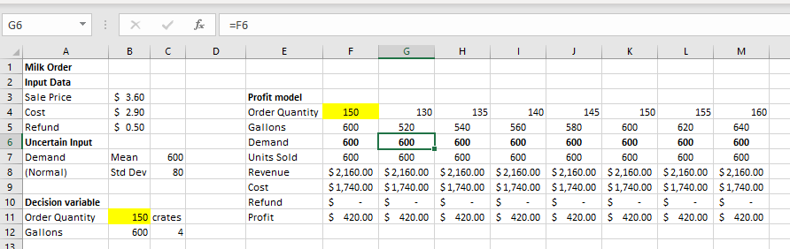
How many crates?
Use same demand generator, recompute for different crate quantities:

Slide 32
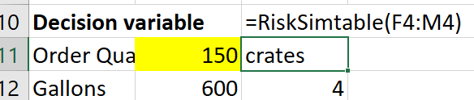
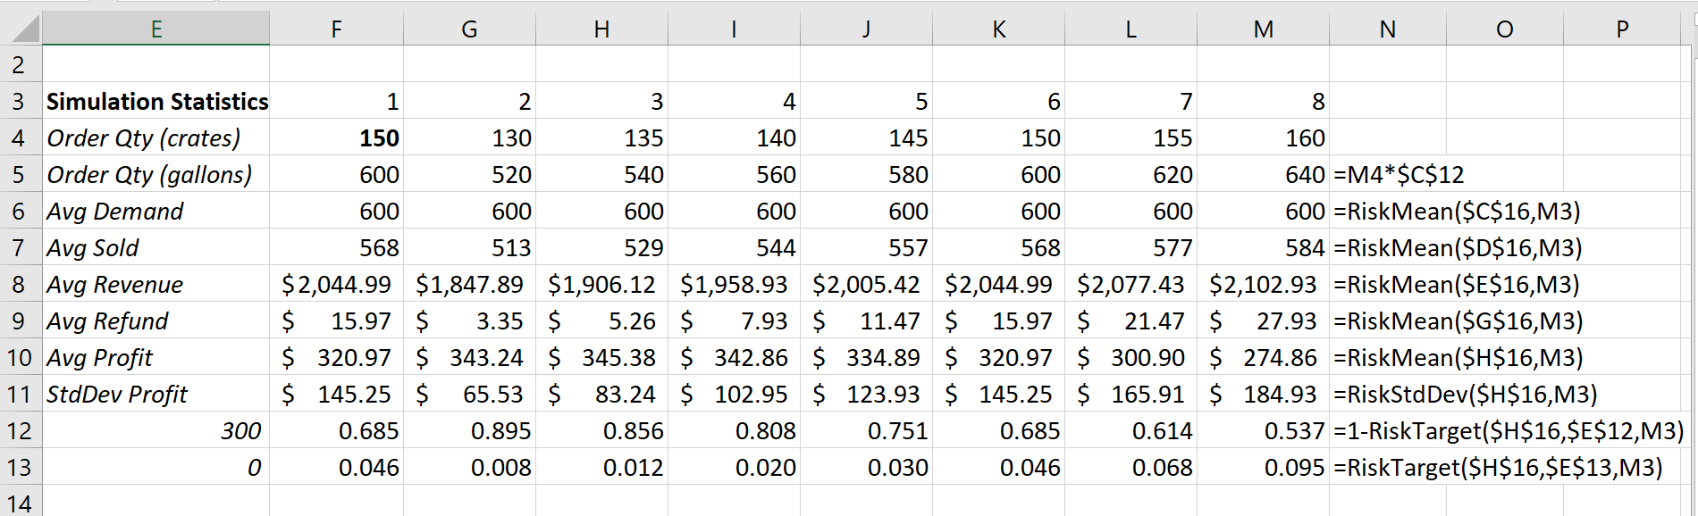
How many crates?
Alternative (better summary of the results): RISKSIMTABLE

Slide 33
@Risk Common Functions
RiskNormal(mean, stdev): generates random numbers following normal distribution with “mean” and “stdev”.
RiskMean(output, sim#): calculates the mean for output in simulation#.
RiskStdDev(output, sim#): calculates the standard deviation for output in simulation#.
RiskTarget(output, target, sim#): calculates the proportion (probability) that the output is below target in simulation#.
Sim# is optional and only necessary if multiple simulations are run with alternative inputs.
RiskSimTable(alternative): provide the list of alternatives

Slide 34
Interpreting the results

Slide 35
The Uncertainty of Sampling
There are infinitely many possible simulations; another run would produce different results
As the number of replications increases, the sample statistics converge to the “true” population values
The sample statistics, like the sample mean, are themselves an estimate of the true average earnings
To find out the true mean we would have to conduct an infinite number of replications in the simulation
Therefore, we put confidence intervals around the statistics (such as the mean) that emerge from the simulation

Slide 36
Milk Order
What is the distribution of profit at the selected order level?
What is the mean profit?
What is the standard deviation of profit?
Estimate with 95% confidence the mean profit.

Slide 37
Constructing a Confidence Interval for the True Population Mean
where:
Note that as n increases, the width of the confidence interval decreases.

Slide 38
Simulation vs Averages
What is the best order quantity if we use average demand?
What would be the “estimated” profit?
Is that a good estimate? What is the whole story?
FLAW OF AVERAGES

Slide 39
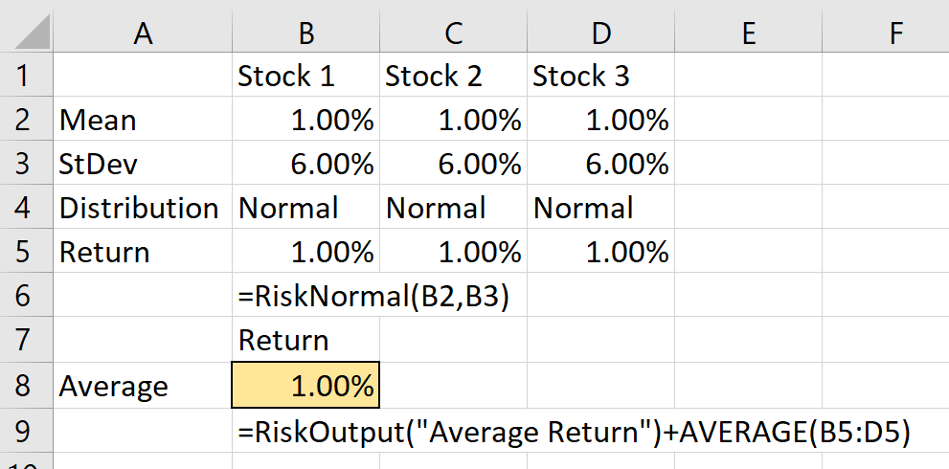
MULTIPLE UNCERTAIN INPUTS
Suppose you are going to invest equal amounts in three stocks. The annual return from each stock is normally distributed with mean 0.01 (1%) and standard deviation 0.06. The annual return on your portfolio, the output variable interest, is the average of three stock returns.
Run @Risk, using 1000 iterations, assuming the returns of the three stocks are independent of each other.

Slide 40
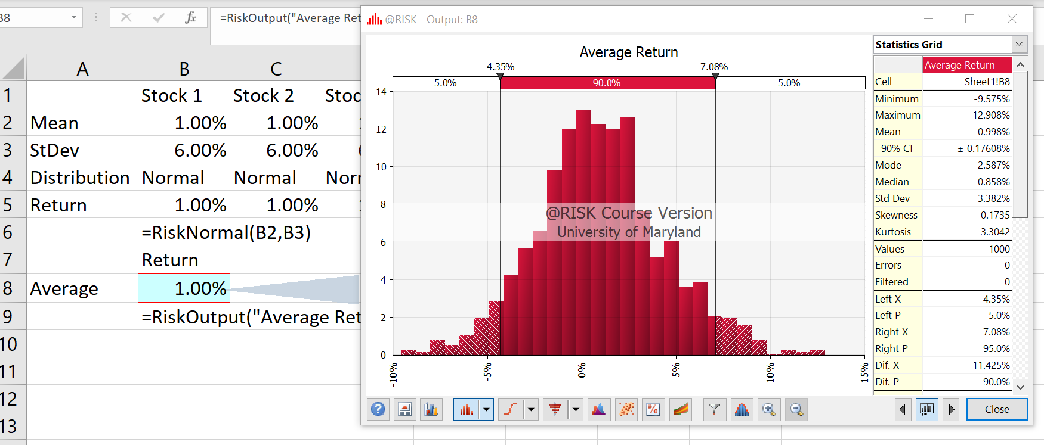
MULTIPLE UNCERTAIN INPUTS

Slide 41
Correlated random inputs
Consider now the following three scenarios:
The three stock returns are highly correlated. The correlation between each pair is 0.9.
The three stock returns are practically independent. The correlation between each pair is 0.1.
The first two stocks are moderately correlated. The correlation between their returns is 0.4. The third stock’s return is negatively correlated with the other two. The correlation between its return and each of the first two is -0.8.
Compare the portfolio distributions from @Risk for these three scenarios. What do you conclude?

Slide 42
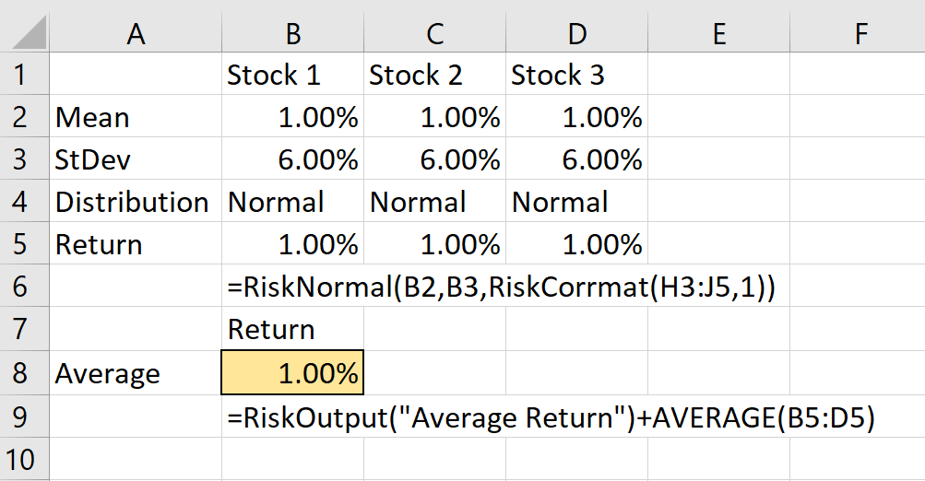
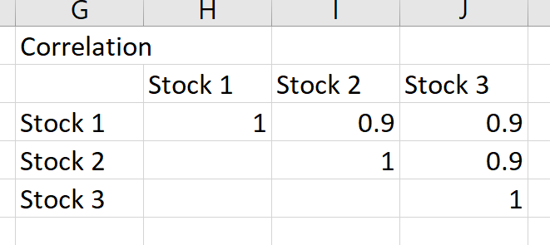
Correlated random inputs
Consider now the following three scenarios:
The three stock returns are highly correlated. The correlation between each pair is 0.9.

Slide 43
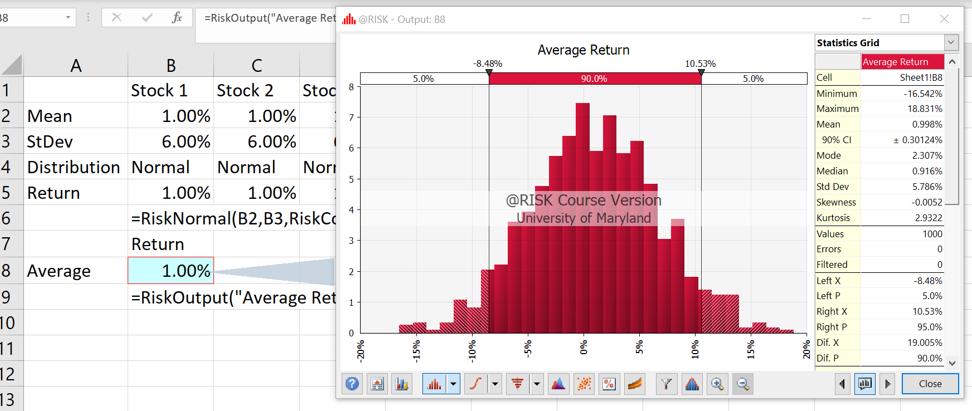
Correlated random inputs
Consider now the following three scenarios:
The three stock returns are highly correlated. The correlation between each pair is 0.9.

Slide 44
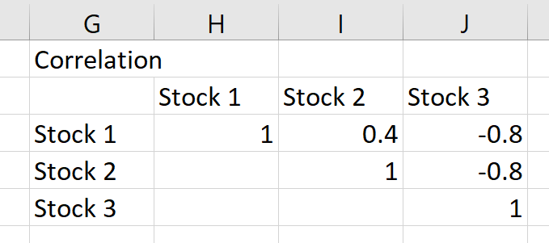
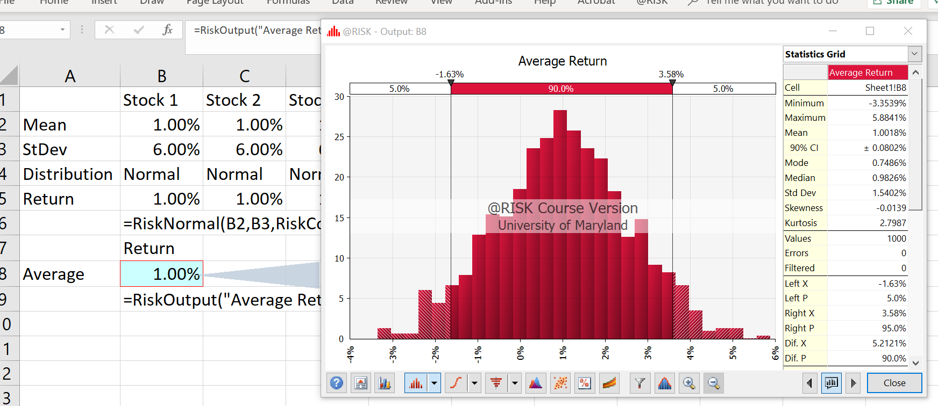
Correlated random inputs
Consider now the following three scenarios:
The first two stocks are moderately correlated. The correlation between their returns is 0.4. The third stock’s return is negatively correlated with the other two. The correlation between its return and each of the first two is -0.8.

Slide 45
Correlated random inputs
Consider now the following three scenarios:
The three stock returns are highly correlated. The correlation between each pair is 0.9.
The three stock returns are practically independent. The correlation between each pair is 0.1.
The first two stocks are moderately correlated. The correlation between their returns is 0.4. The third stock’s return is negatively correlated with the other two. The correlation between its return and each of the first two is -0.8.
Compare the portfolio distributions from @Risk for these three scenarios. What do you conclude?

Slide 46
Simulation Recap
The technique that we studied and saw how to implement is called Monte Carlo Simulation.
Simulation models are very useful when it is important to understand the risks associated with a decision (in a quantitative way).
Simulation is very useful in marketing analysis, capital budgeting, and the strategic analysis of investment alternatives as well.
In summary, Simulation is a very powerful managerial decision-making tool.

